Slide 1
Machine Learning
Niels Peek

Slide 2
Overview
Introduction
Decision trees
Random forests
Support vector machines
Neural networks
Is machine learning better than statistical modelling?

Slide 3
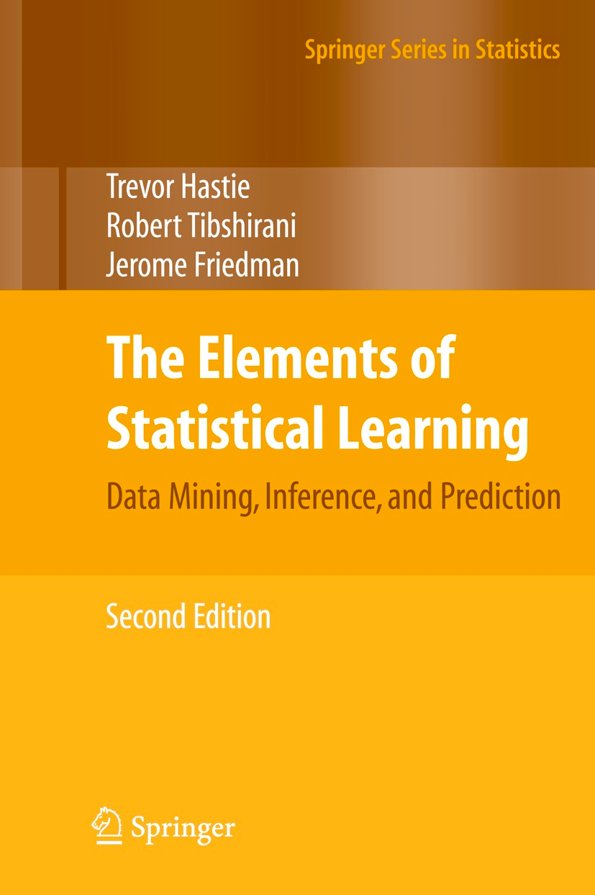
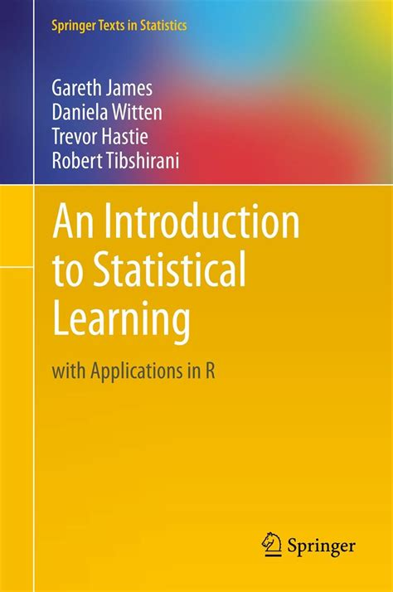
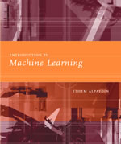
Good books

Slide 4
Online courses
Statistical Learning (Trevor Hastie, Robert Tibshirani) Stanford School of Humanities and Sciences
Machine Learning (Andrew Ng) Coursera

Slide 5
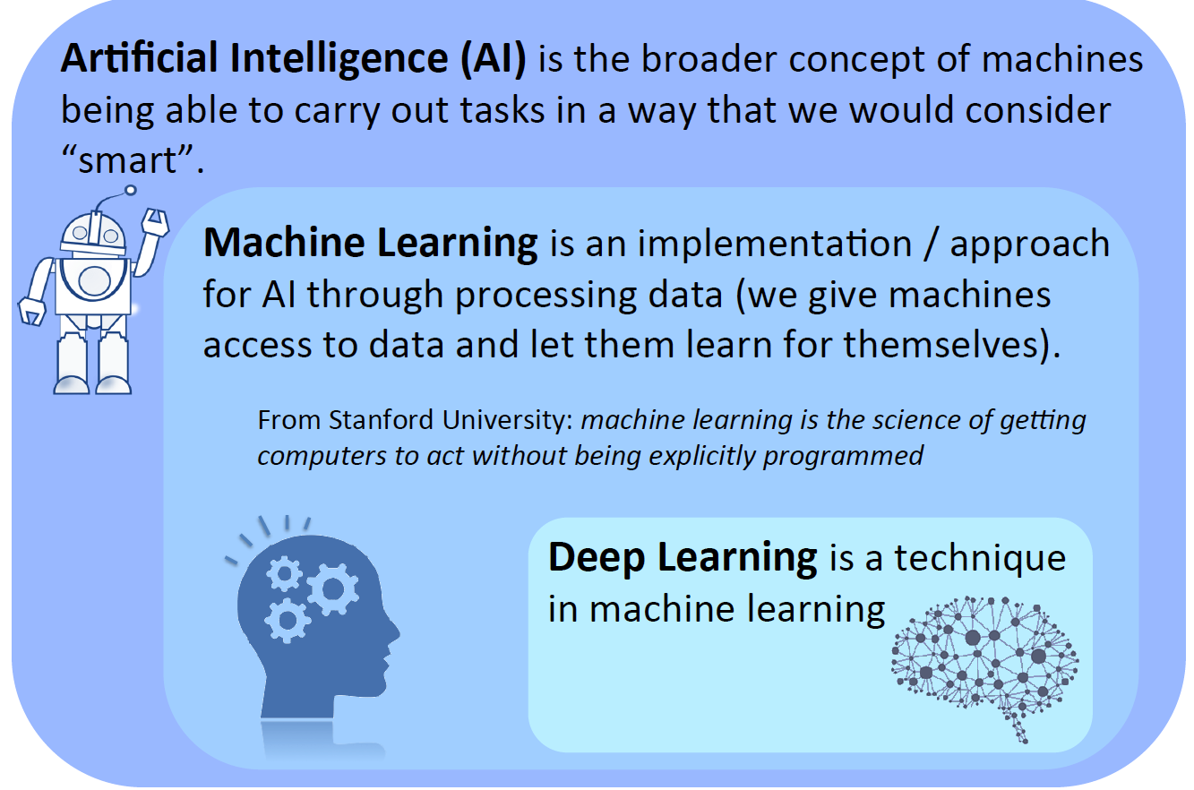
Introduction

Slide 6
What is Learning?
Learning = Improving with experience at some task
Improve over task T
with respect to performance measure P
based on experience E
E.g. Learn to play checkers
T = play checkers
P = % of games won
E = opportunity to play

Slide 7
Types of ML
Machine Learning
The correct classes/labels of the training data are known
Regression/ classification
This is what we will focus on today
Supervised

Slide 8
Types of ML
Machine Learning
Supervised
Unsupervised
The correct classes/labels of the training data are NOT known
Clustering/ pattern discovery

Slide 9
Types of ML
Machine Learning
Supervised
Unsupervised
Reinforcement
Learning from feedback from environment (e.g. self-driving cars)

Slide 10
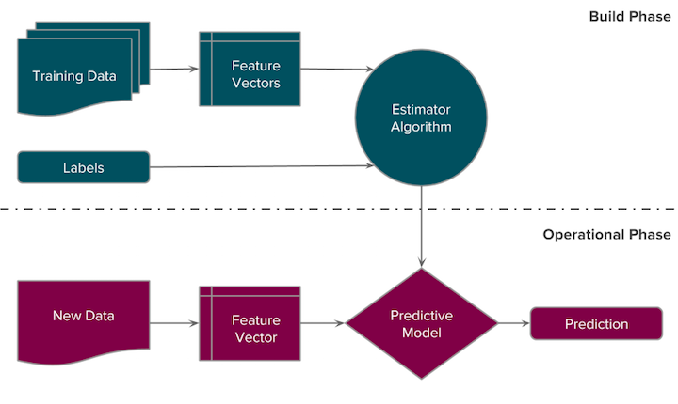
Supervised learning

Slide 11
Machine Learning vs. Statistics
Machine Learning
Field is defined by problem type
Starting point: deterministic functions
Goal is fully automated learning
Focus on representational expressiveness
Heavy use of search algorithms
Statistical Modelling
Field is defined by solution (regression)
Starting point: stochastic functions (probability distributions)
Important role for analyst
More attention for bias/variance tradeoff

Slide 12
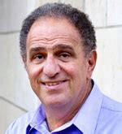
Robert Tibshirani

Slide 13

From a presentation by Tom Liptrot

Slide 14
Overview
Introduction
Decision trees
Random forests
Support vector machines
Neural networks
Is machine learning better than statistical modelling?

Slide 15
Decision trees
Bronner MB, et al. J Trauma Stress. 2009 Feb;22(1):74-8.

Slide 16
Trees: segmenting the input space
From a lecture by Trevor Hastie & Robert Tibshirani

Slide 17
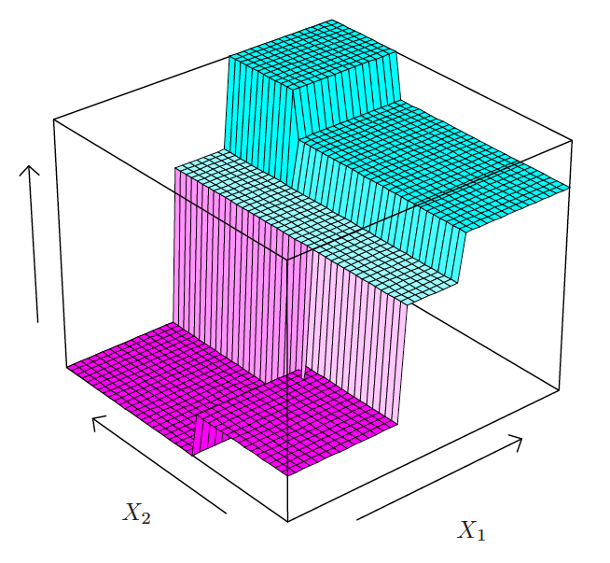
Trees: segmenting the input space
From a lecture by Trevor Hastie & Robert Tibshirani

Slide 18
Selecting the optimal size of the tree
From a lecture by Trevor Hastie & Robert Tibshirani

Slide 19
Trees versus linear models
Strengths:
Easy to explain
Both for classification and regression (probabilistic risk prediction)
Can easily handle problems with >2 classes
Natural ability to model interactions
Integrated methods for handling missing values
Weaknesses
Performance is not competitive compared to other ML methods
From a lecture by Trevor Hastie & Robert Tibshirani

Slide 20
Overview
Introduction
Decision trees
Random forests
Support vector machines
Neural networks
Is machine learning better than statistical modelling?

Slide 21
Bootstrap aggregation (bagging)
From a lecture by Trevor Hastie & Robert Tibshirani

Slide 22
Bootstrap aggregation (bagging) – continued
From a lecture by Trevor Hastie & Robert Tibshirani

Slide 23
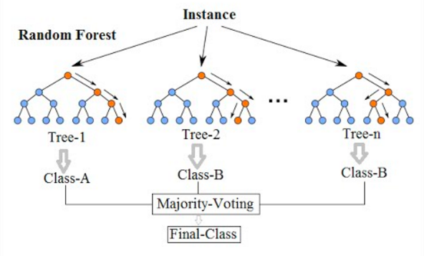
Bagging depicted
Tree 1
Tree 2
Tree B
Prediction 1
Prediction 2
Prediction B
Bagged prediction

Slide 24
Random forests
Random forests provide an improvement over bagged trees by way of a small tweak that decorrelates the trees. This reduces the variance when we average the trees.
As in bagging, we build a number of decision trees on bootstrapped training samples.
But when building these decision trees, each time a split in a tree is considered, a random selection of m predictors is chosen as split candidates from the full set of p predictors. The split is allowed to use only one of those m predictors.
A fresh selection of m predictors is taken at each split.
From a lecture by Trevor Hastie & Robert Tibshirani

Slide 25
How to choose the parameter m?
For many datasets, m ≈ sqrt(p) is a good choice. That is, the number of predictors considered at each split is approximately equal to the square root of the total number of predictors.
It is also possible to optimise m on the training data, using cross-validation. This is what we will do in the computer practical.
From a lecture by Trevor Hastie & Robert Tibshirani

Slide 26
Random forests – example
Strengths:
Easy to explain
Both for classification and regression (probabilistic risk prediction)
Can easily handle problems with >2 classes
Natural ability to model interactions
Integrated methods for handling missing values
Competitive performance
Weaknesses
‘Black box’ character
Computationally intensive
From a lecture by Trevor Hastie & Robert Tibshirani

Slide 27
Overview
Introduction
Decision trees
Random forests
Support vector machines
Neural networks
Is machine learning better than statistical modelling?

Slide 28
Support Vector Machines (SVMs)

Slide 29
Support Vectors

Slide 30
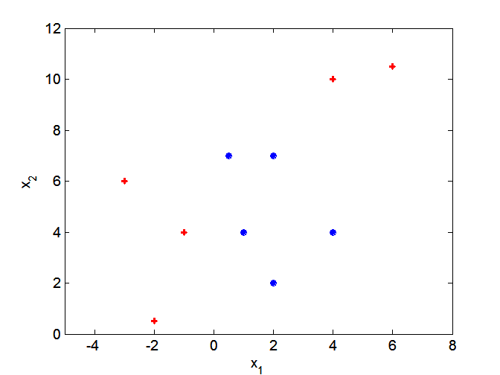
What if decision boundary is not linear?

Slide 31
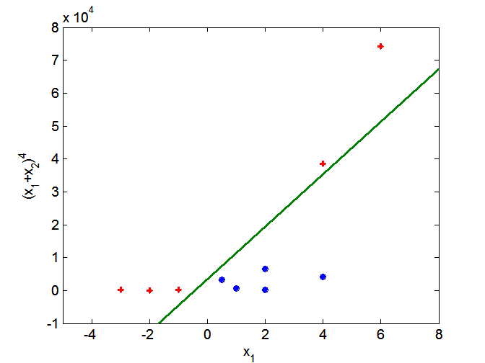
Nonlinear SVMs
Transform data into higher dimensional space
Strengths:
Very good when classes are (nearly) separable
Can model nonlinear relationships
Can easily handle very sparse datasets
Weaknesses
‘Black box’ character
Needs workaround with >2 classes
Struggles with “noise” (overlapping classes)
Not good at estimating probabilities (risk prediction)
Not good with highly unbalanced class distributions

Slide 32
Overview
Introduction
Decision trees
Random forests
Penalised regression
Support vector machines
Neural networks
Is machine learning better than statistical modelling?

Slide 33
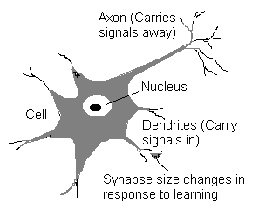
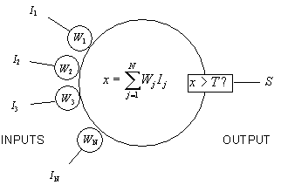
The artificial neuron
Valentin, 1836
McCulloch & Pitts, 1943

Slide 34
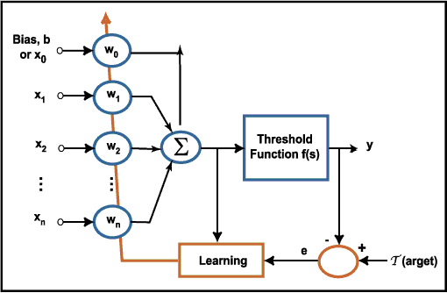
Perceptron (Rosenblatt, 1958)

Slide 35
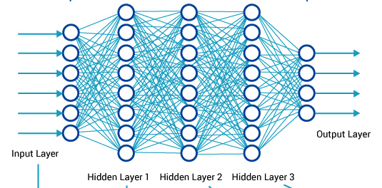
Multilayer perceptron

Slide 36
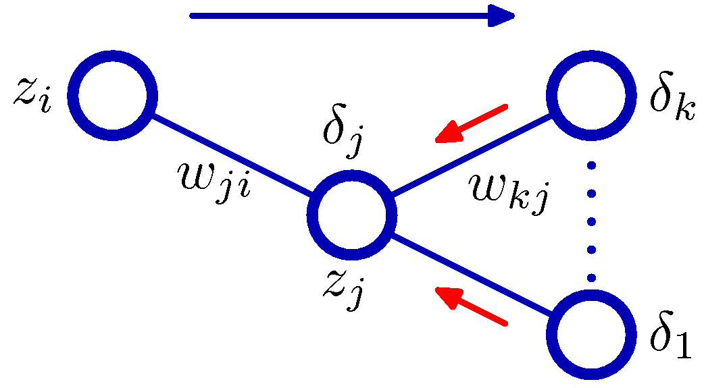
Backpropagation
The hidden unit error δ_{j} is calculated by backpropagation of the δ ’s from units k to which unit j sends connections.
The blue arrow denotes the direction of information flow during forward propagation, and the red arrows indicate the backward propagation of error information.

Slide 37
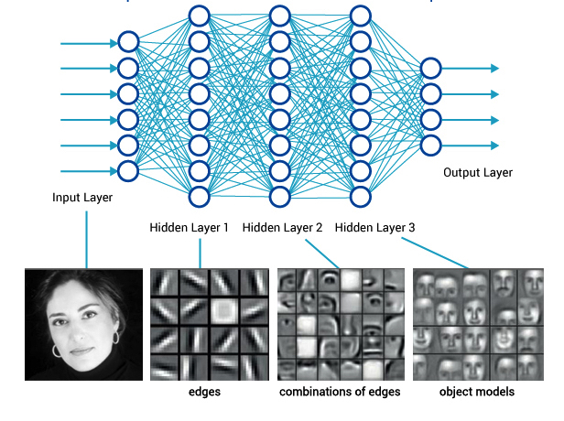
Image recognition

Slide 38
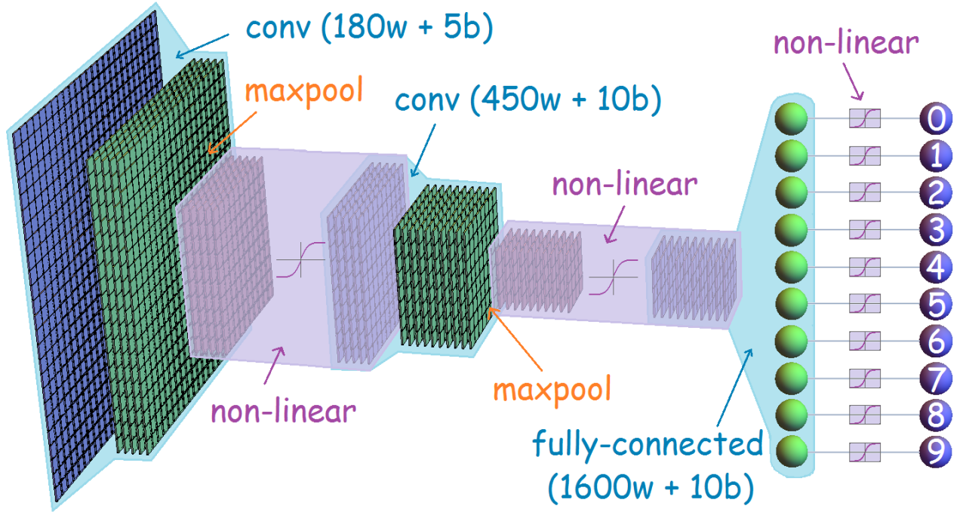
Deep convolutional neural networks

Slide 39
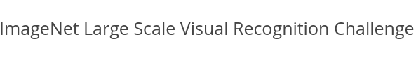
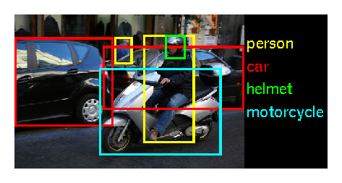

Slide 40
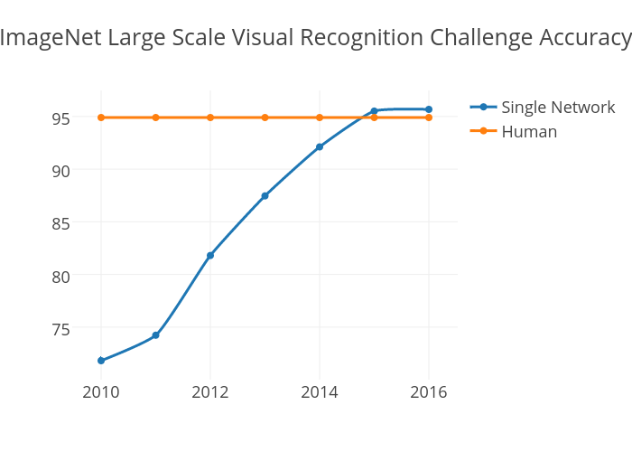

Slide 41
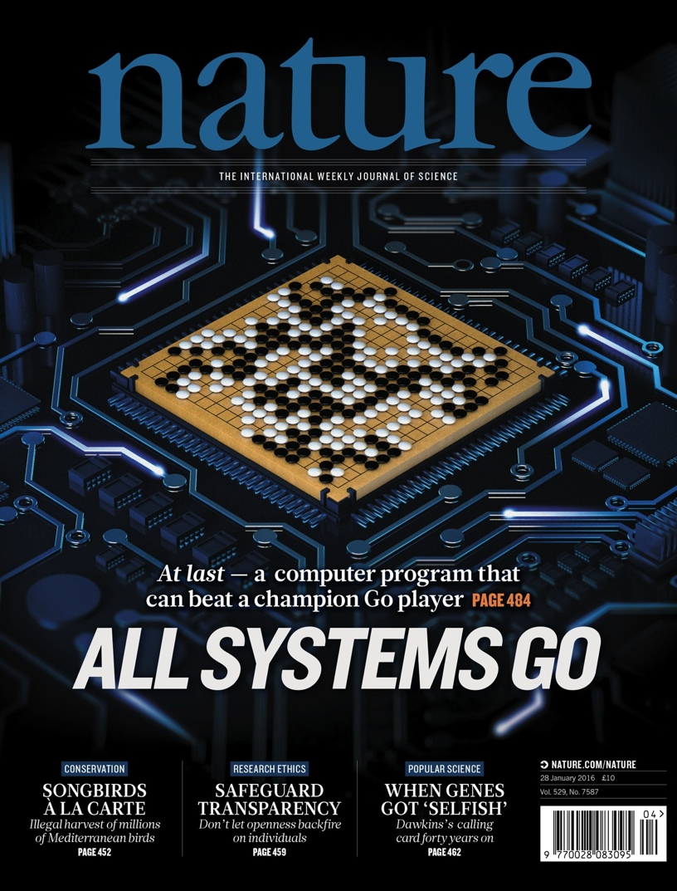
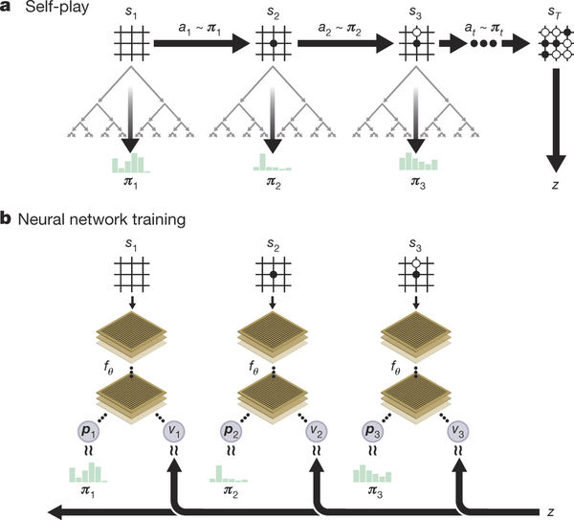
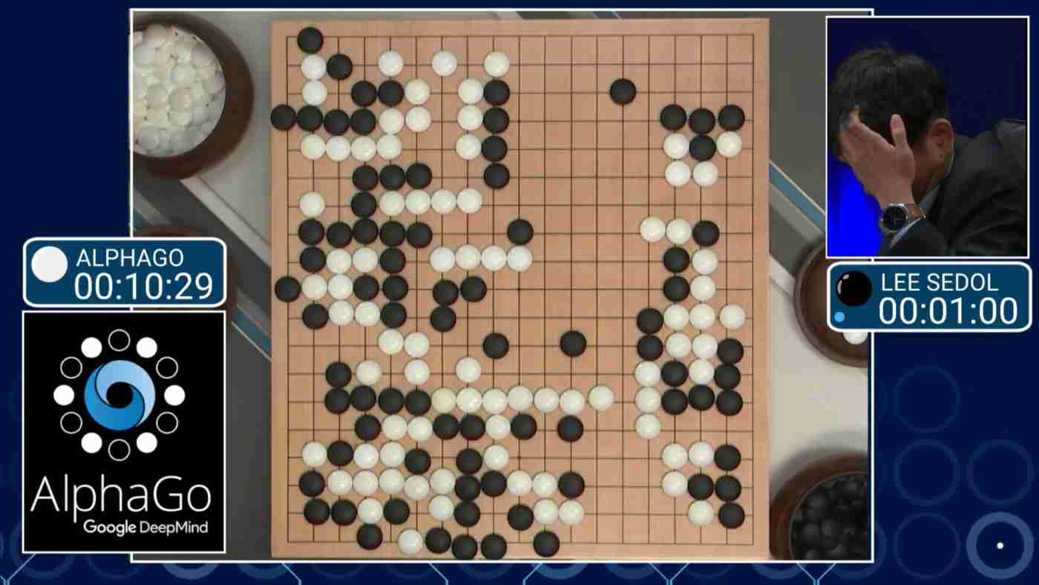
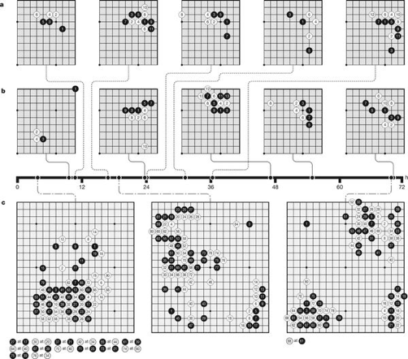
2016

Slide 42

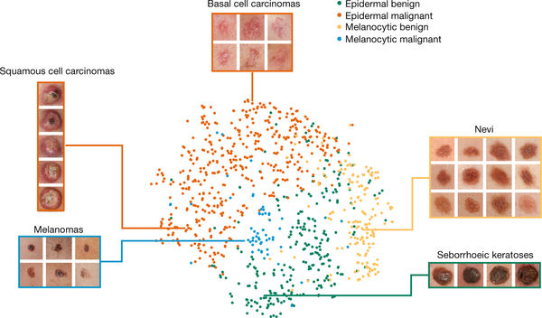
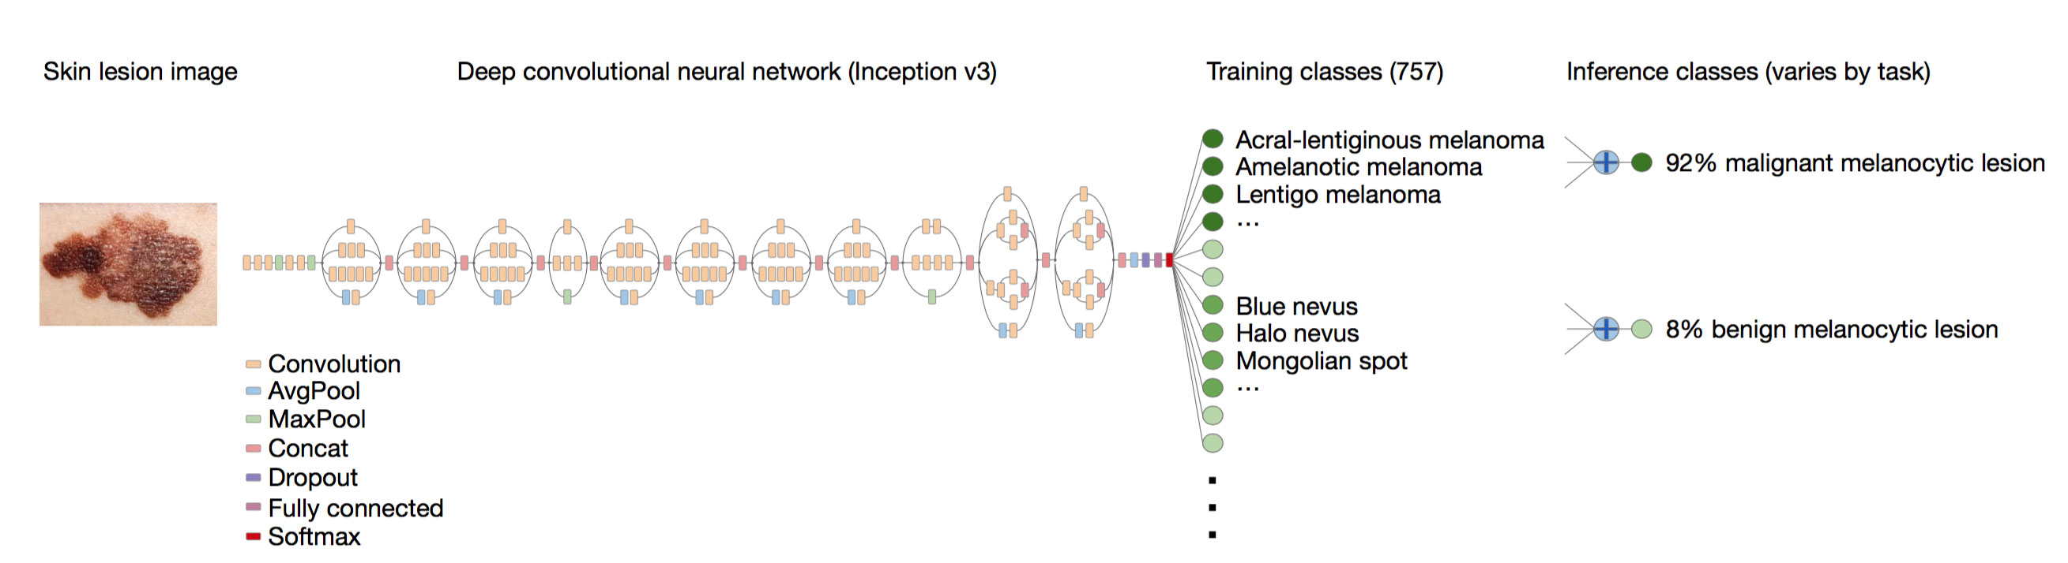
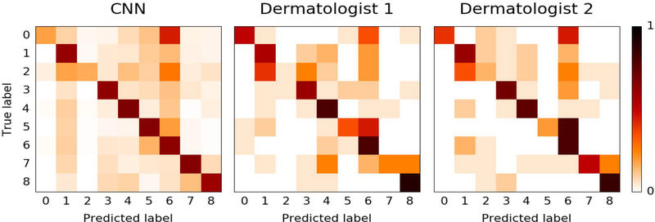
(n=129,450)
(pretrained on approximately 1.28m images)
Esteva et al. Nature 2016;542:115-8.

Slide 43
Neural networks
Strengths:
Ability to learn relevant patterns in the input data
Can have multiple (related) output nodes
Can model nonlinear relationships
Natural ability to model interactions
Weaknesses
‘Black box’ character
Very “data hungry”
Computationally intensive

Slide 44
Overview
Introduction
Decision trees
Random forests
Support vector machines
Neural networks
Is machine learning better than statistical modelling?

Slide 45
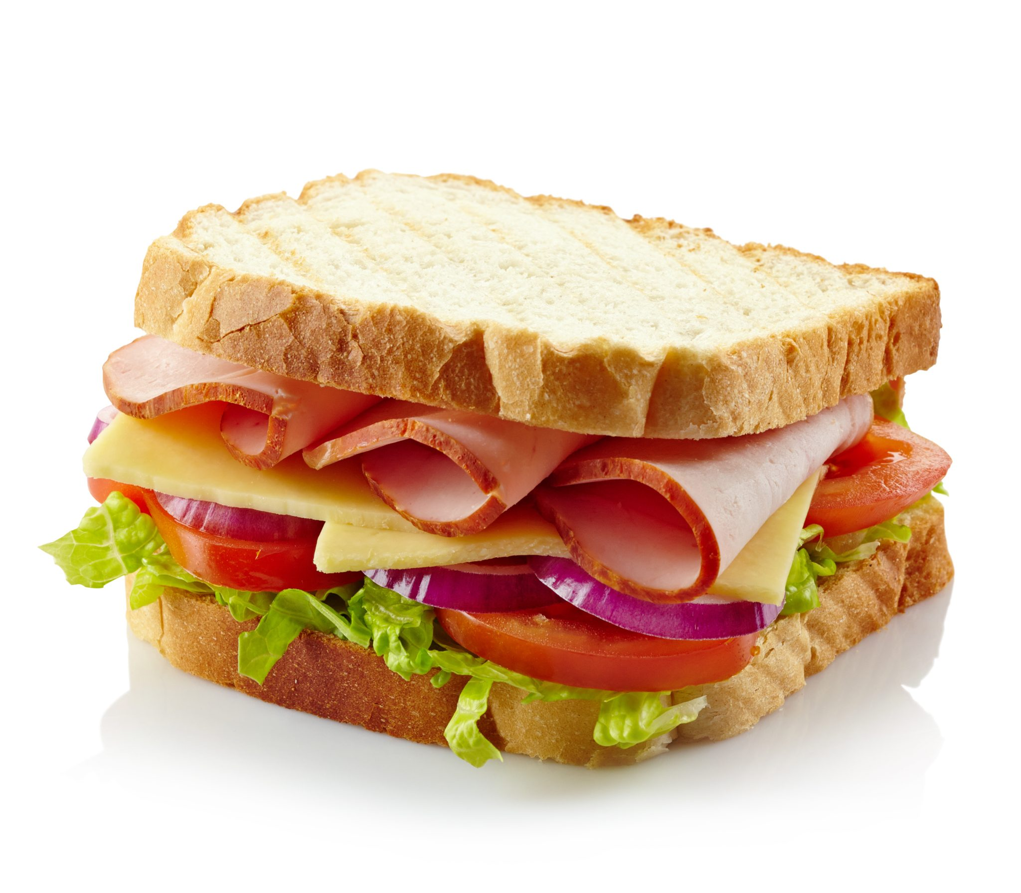
“No free lunch” theorem
Medinfo offers you a free lunch every day at 13.10.
In data science, that does not exist.
Each modelling method makes certain assumptions.
Assumptions that work well in one domain may break down in another.
So, there is no single modelling method that works best for all problems.

Slide 46
Stylianou et al., Burns 2015;41:925-934.

Slide 47
Taylor et al., PLoS ONE 2018;13(3): e0194085.

Slide 48
Christodoulou et al., J Clin Epidemiol 2019;110:12-22.

Slide 49
So, when to use what?
Decision trees are not competitive in terms of performance
Random forests, support vector machines and neural networks are all state-of-the-art machine learning methods
Random forests can easily handle categorical predictor variables, model interactions, and make predictions for >2 outcomes classes
Support vector machines are superior when classes are (nearly) separable, but not good for estimating probabilities (risk prediction)
Neural networks are superior for poorly structured input spaces (e.g. text, images) but computationally intensive and data hungry
For risk prediction, methods that are rooted in regression are always preferable for highly unbalanced outcome distributions

Slide 50
Overview
Introduction
Decision trees
Random forests
Support vector machines
Neural networks
Is machine learning better than statistical modelling?

Slide 51
Summary: Machine Learning
Machine Learning is a subfield of AI focusing on automated learning of tasks from data
There exists a broad array of ML methods, each with their own strengths and weaknesses
It makes sense to consider statistical modelling and ML as one field (statistical learning)
Random forests, SVMs and (deep) neural networks have the potential to learn very complex functions from data
They all have a ‘black box’ character
There are no huge performance differences between “machine learning” and “statistical modelling” for risk prediction in health

Slide 52
Further reading
Hastie, Tibshirani, Friedman. The Elements of Statistical Learning. Springer, 2009.
James, Witten, Hastie, Tibshirani. An Introduction to Statistical Learning. Springer, 2013.
Alpaydin. Introduction to Machine Learning. MIT Press, 2014.
Bronner MB, et al. J Trauma Stress. 2009;22(1):74-8.
Stylianou et al., Burns 2015;41:925-934.
Taylor et al., PLoS ONE 2018;13(3): e0194085.
Christodoulou et al., J Clin Epidemiol 2019;110:12-22.

Slide 53

Questions?

